Slide 1

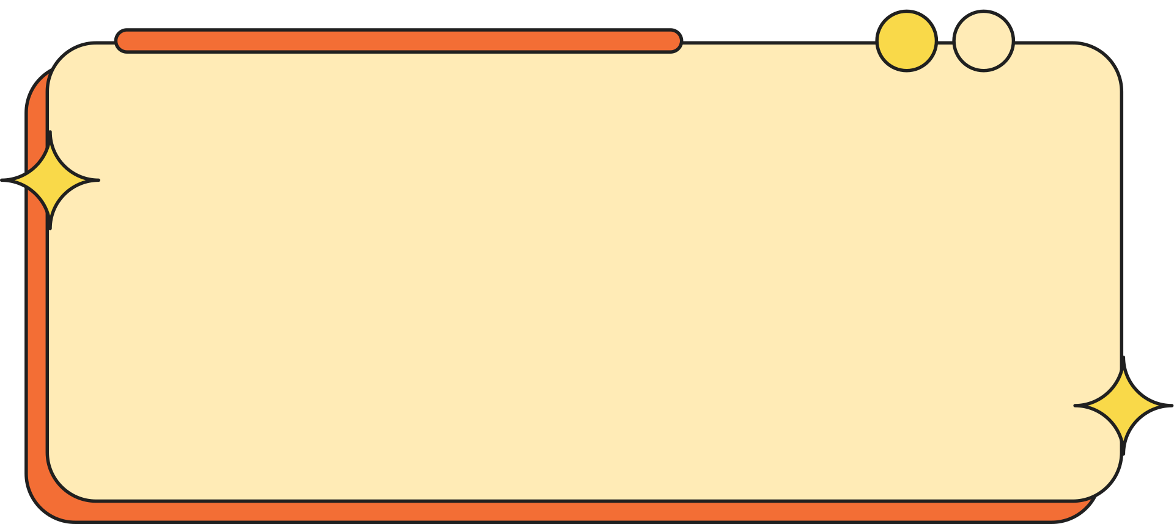


THE TASK MANAGER - A TODO LIST
Presented By CUBEIOD Group

Slide 2
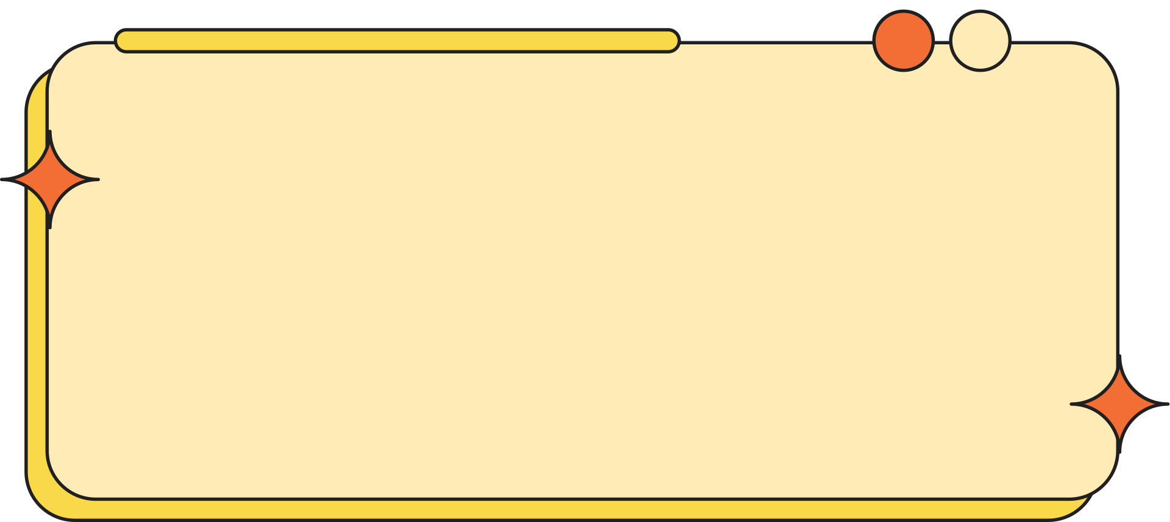

INTRODUCTION
This study aims to enhance the functionality of a task manager by optimizing these operations to improve overall performance and efficiency. The development process involves creating an interactive console interface for real-time user interaction and status monitoring. Furthermore, the program's capabilities will be tested and evaluated, emphasizing the efficiency of task operations, particularly in terms of insertion, deletion, and retrieval. By addressing these aspects, the project seeks to offer a streamlined and effective solution for managing tasks in a user-friendly environment.

Slide 3
WHY WE MADE THE STUDY
We decided to work on this project because we wanted to solve everyday problems related to task organization. Many people, including us, sometimes feel overwhelmed by the number of tasks they need to finish. We wanted to create a tool that helps users keep track of their tasks in a simple and efficient way. At the same time, this project gave us a chance to improve our programming skills and learn how to use linked lists for practical applications.

Slide 4
RELEVANCE OF THE STUDY
This study is important because task management is a common challenge for students, professionals, and anyone with busy schedules. By applying what we learned in data structures, we could show how linked lists can solve real-life problems. This project is not just about coding but also about creating something useful that can help people manage their time better and reduce stress.

Slide 5
STATEMENT OF THE PROBLEM
Many people struggle with organizing and managing their tasks efficiently, leading to confusion, missed deadlines, and reduced productivity. Traditional paper-based to-do lists lack flexibility, while some software tools may be too complex or inaccessible. This project addresses the following questions:
How can a doubly linked list be used to create a simple yet efficient task manager?
What are the benefits of using a doubly linked list for task operations like insertion, deletion, and retrieval?
How can a console-based interface be designed to provide a user-friendly way to manage tasks?
How efficient is the task manager in handling dynamic task data?

Slide 6
SCOPE AND DELIMITATION
Scope:
The study focuses on developing a task manager application using C++ and a doubly linked list as the primary data structure.
The application provides essential features, including:
Adding new tasks.
Displaying all tasks with their status (pending, completed, or canceled).
Marking tasks as completed or canceled.
Deleting tasks.
Saving tasks to a file for future reference.
The program includes a console-based interface for user interaction, ensuring simplicity and accessibility.
The system is designed for small-scale personal use, such as managing daily tasks.

Slide 7
SCOPE AND DELIMITATION
Delimitation:
The study does not include advanced features such as task reminders, deadlines, or notifications.
The program is limited to a console interface, excluding graphical user interface (GUI) development.
It is not integrated with external task management tools or cloud storage systems.
The performance testing focuses on typical workloads and does not evaluate scalability for handling very large datasets.
The task manager is intended for individual users, not for team collaboration or multi-user environments.

Slide 8
OBJECTIVES
To implement a dynamic task storage system using a doubly linked list.
To design and develop key functionalities such as adding, deleting, and marking tasks.
To create a console-based interface for easy user interaction.
To evaluate the task manager's efficiency through performance testing.
To learn and apply data structure concepts in solving real-world problems.

Slide 9
METHODS
We followed these steps to create the task manager:
Requirements Gathering:
We identified the main features, like adding, displaying, completing, canceling, and deleting tasks.
These features became the core functions of the console interface.
System Design:
We chose a doubly linked list because it allows tasks to be managed flexibly.
We made flowcharts and pseudocode to plan how each operation (like adding or deleting tasks) would work.

Slide 10
METHODS
Implementation:
We wrote the code in C++ using a doubly linked list to store tasks.
A simple console interface was developed to make it easy for users to interact with the program.
Testing:
We tested each function individually (like adding or deleting tasks) to ensure they worked correctly.
We also checked if all the parts worked together smoothly and measured how well the program handled multiple tasks.

Slide 11
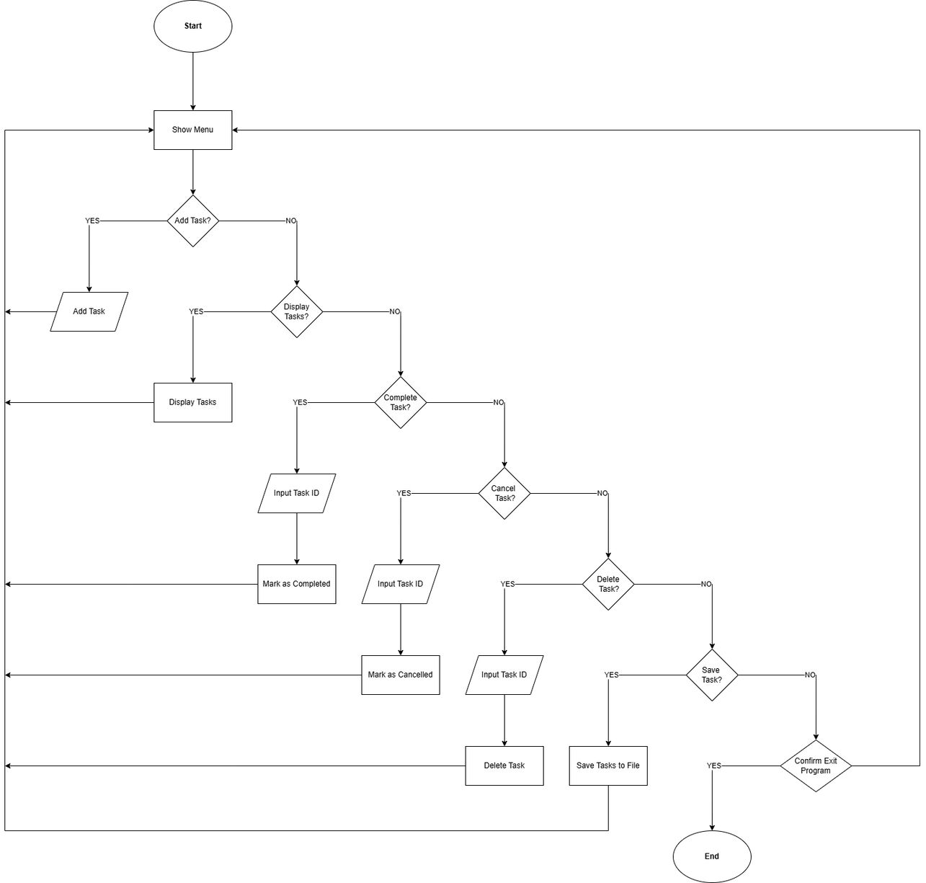

Slide 12
RESULTS
The task manager successfully demonstrated the following:
Efficiently adding tasks with unique IDs using a doubly linked list structure.
Displaying all tasks with their statuses (pending, completed, or canceled) through a user-friendly console interface.
Marking tasks as completed or canceled and deleting tasks from the list.
Saving task data to a file for future retrieval, ensuring persistence across program runs.
During testing, the program consistently handled tasks with minimal delays, showing the efficiency of the doubly linked list for dynamic task operations. The console interface was simple and intuitive, making it accessible for users with basic computer skills. However, performance under extremely large datasets was not tested, as the scope of the study was limited to small-scale personal use.

Slide 13
DISCUSSION
The project demonstrated the versatility and efficiency of using doubly linked lists for task management. The bidirectional nature of the linked list allowed for flexible task traversal, while dynamic memory allocation ensured efficient use of resources. The console interface was simple yet effective, meeting the requirements of a user-friendly application.
Some challenges were encountered during debugging and testing phases, particularly in managing task IDs and ensuring seamless integration of features. These issues were resolved through iterative testing. Future improvements could include integrating a graphical user interface (GUI), adding task prioritization based on deadlines, and enhancing performance for larger datasets.

Slide 14
CONCLUSION
The project successfully achieved its objectives of creating a task manager using C++ and a doubly linked list. It provided efficient task operations such as adding, displaying, marking, and deleting tasks while ensuring data persistence through file saving. The study highlights the practicality of linked lists in solving real-world problems and demonstrates how C++ can be effectively applied to create dynamic applications.

Slide 15
CONCLUSION
By focusing on a console-based interface, the task manager offered a straightforward and functional solution for task management, particularly for individuals. While the program performed well within the defined scope, future developments could include features like task prioritization, reminders, and integration with other tools to enhance usability. Overall, the study serves as a strong example of how data structures can be used to improve productivity and solve practical challenges.

Slide 16
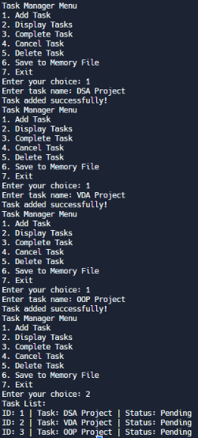
DOCUMENTATION

Slide 17


THANK YOU
Presented By Cubeoid Group

